Slide 1

Chapter 8
Encipherment Using
Modern Symmetric-Key Ciphers
Copyright © The McGraw-Hill Companies, Inc. Permission required for reproduction or display.

Slide 2
Chapter 18
Objectives
❏ To show how modern standard ciphers, such as
DES or AES, can be used to encipher long
messages.
❏ To discuss five modes of operation designed to be
used with modern block ciphers.
❏ To define which mode of operation creates stream
ciphers out of the underlying block ciphers.
❏ To discuss the security issues and the error
propagation of different modes of operation.
❏ To discuss two stream ciphers used for real-time
processing of data.

Slide 3
8-1 USE OF MODERN BLOCK CIPHERS
Symmetric-key encipherment can be done using modern block ciphers. Modes of operation have been devised to encipher text of any size employing either DES or AES.
Topics discussed in this section:
8.1.1 Electronic Codebook (ECB) Mode
8.1.2 Cipher Block Chaining (CBC) Mode
8.1.3 Cipher Feedback (CFB) Mode
8.1.4 Output Feedback (OFB) Mode
8.1.5 Counter (CTR) Mode

Slide 4
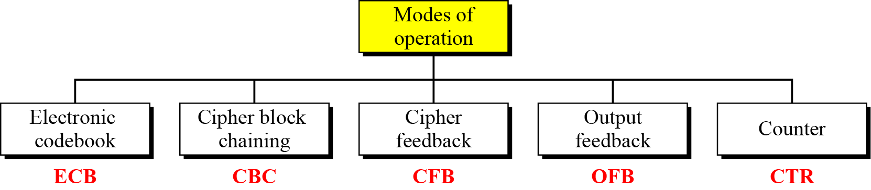
8-1 Continued
Figure 8.1 Modes of operation

Slide 5
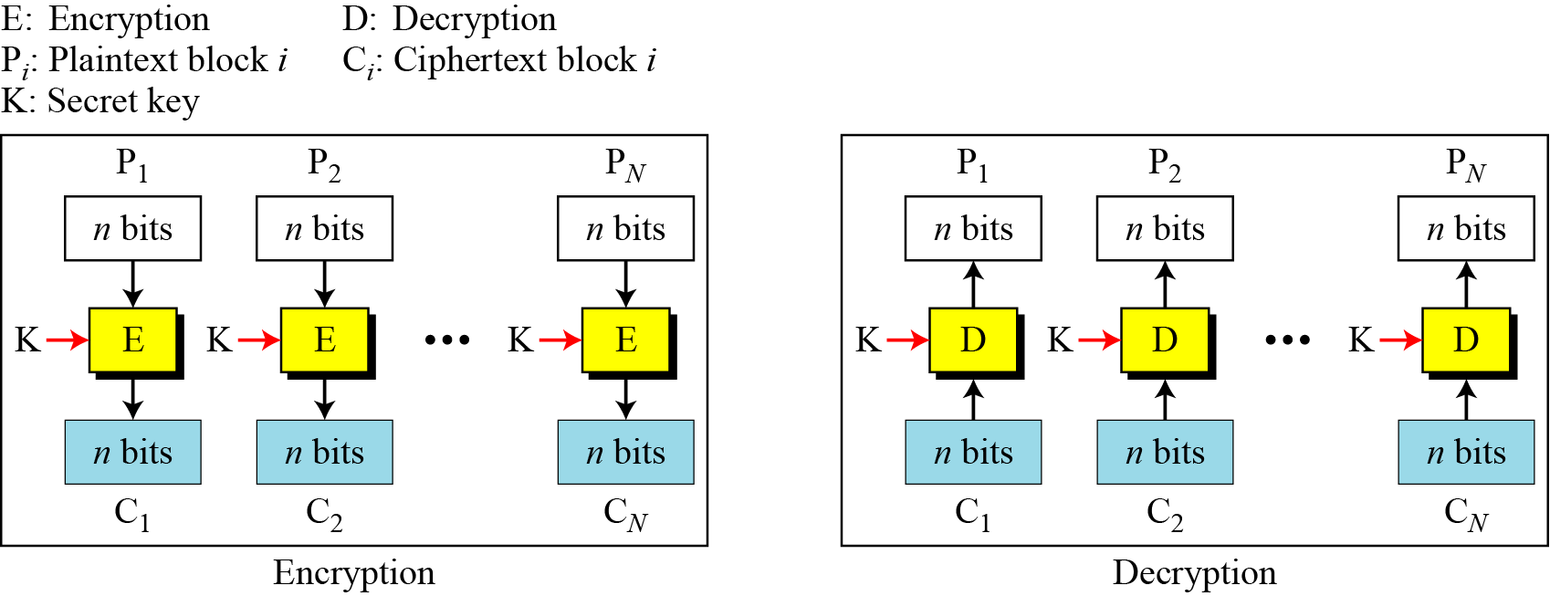
8.1.1 Electronic Codebook (ECB) Mode
The simplest mode of operation is called the electronic codebook (ECB) mode.
Figure 8.2 Electronic codebook (ECB) mode

Slide 6
8.1.1 Continued
Example 8.1
It can be proved that each plaintext block at Alice’s site is exactly recovered at Bob’s site. Because encryption and decryption are inverses of each other,
Example 8.2
This mode is called electronic codebook because one can precompile 2^{K} codebooks (one for each key) in which each codebook has 2^{n} entries in two columns. Each entry can list the plaintext and the corresponding ciphertext blocks. However, if K and n are large, the codebook would be far too large to precompile and maintain.

Slide 7
8.1.1 Continued
Example 8.3
Assume that Eve works in a company a few hours per month (her monthly payment is very low). She knows that the company uses several blocks of information for each employee in which the seventh block is the amount of money to be deposited in the employee’s account. Eve can intercept the ciphertext sent to the bank at the end of the month, replace the block with the information about her payment with a copy of the block with the information about the payment of a full-time colleague. Each month Eve can receive more money than she deserves.

Slide 8
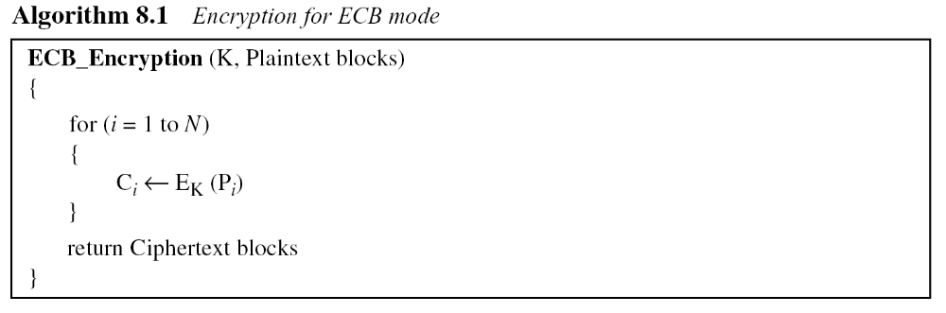
8.1.1 Continued
Error Propagation
A single bit error in transmission can create errors in several in the corresponding block. However, the error does not have any effect on the other blocks.

Slide 9
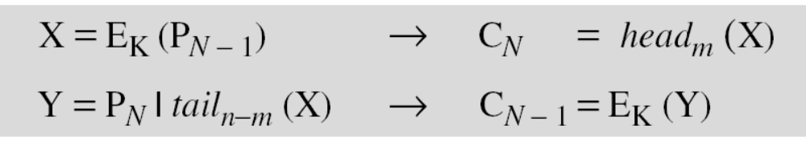
8.1.1 Continued
Ciphertext Stealing
A technique called ciphertext stealing (CTS) can make it possible to use ECB mode without padding. In this technique the last two plaintext blocks, P_{N−1} and P_{N} , are encrypted differently and out of order, as shown below, assuming that P_{N−1} has n bits and P_{N} has m bits, where m ≤ n .

Slide 10
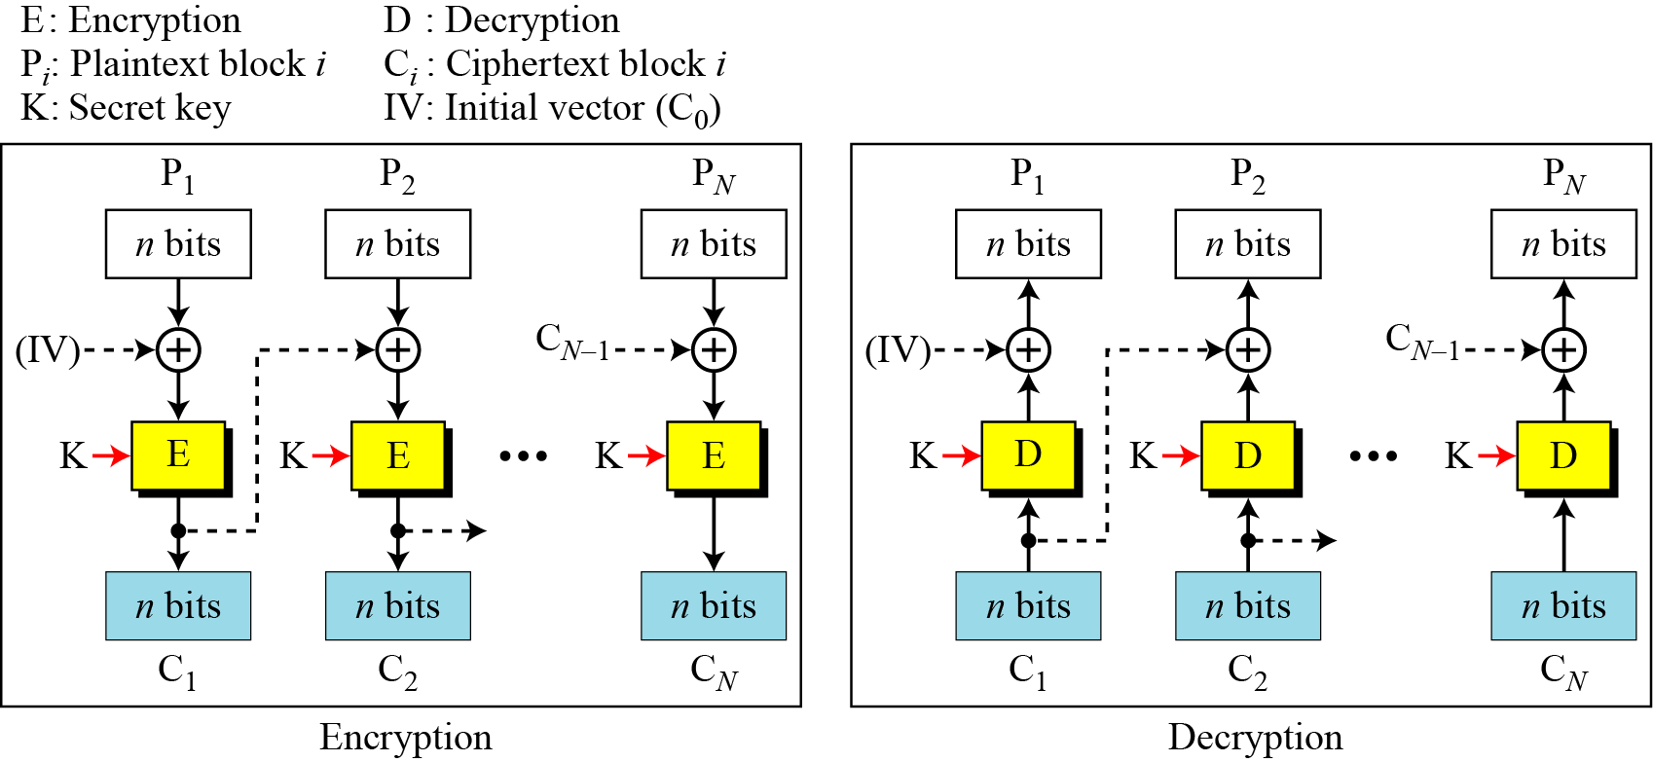
8.1.2 Cipher Block Chaining (CBC) Mode
In CBC mode, each plaintext block is exclusive-ored with the previous ciphertext block before being encrypted.
Figure 8.3 Cipher block chaining (CBC) mode

Slide 11
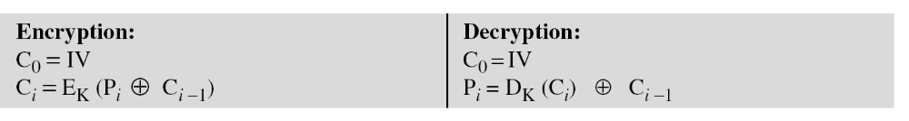
8.1.2 Continued
Figure 8.3 Cipher block chaining (CBC) mode

Slide 12
8.1.2 Continued
Example 8.4
It can be proved that each plaintext block at Alice’s site is recovered exactly at Bob’s site. Because encryption and decryption are inverses of each other,
Initialization Vector (IV)
The initialization vector (IV) should be known by the sender and the receiver.

Slide 13
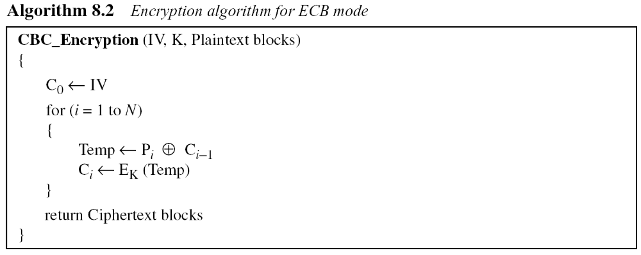
8.1.2 Continued
Error Propagation
In CBC mode, a single bit error in ciphertext block C_{j} during transmission may create error in most bits in plaintext block P_{j} during decryption.

Slide 14
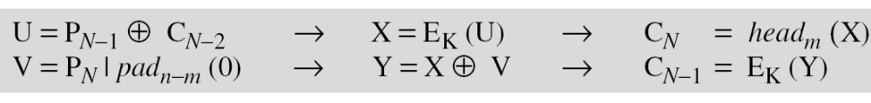
8.1.2 Continued
Ciphertext Stealing
The ciphertext stealing technique described for ECB mode can also be applied to CBC mode, as shown below.
The head function is the same as described in ECB mode; the pad function inserts 0’s.

Slide 15
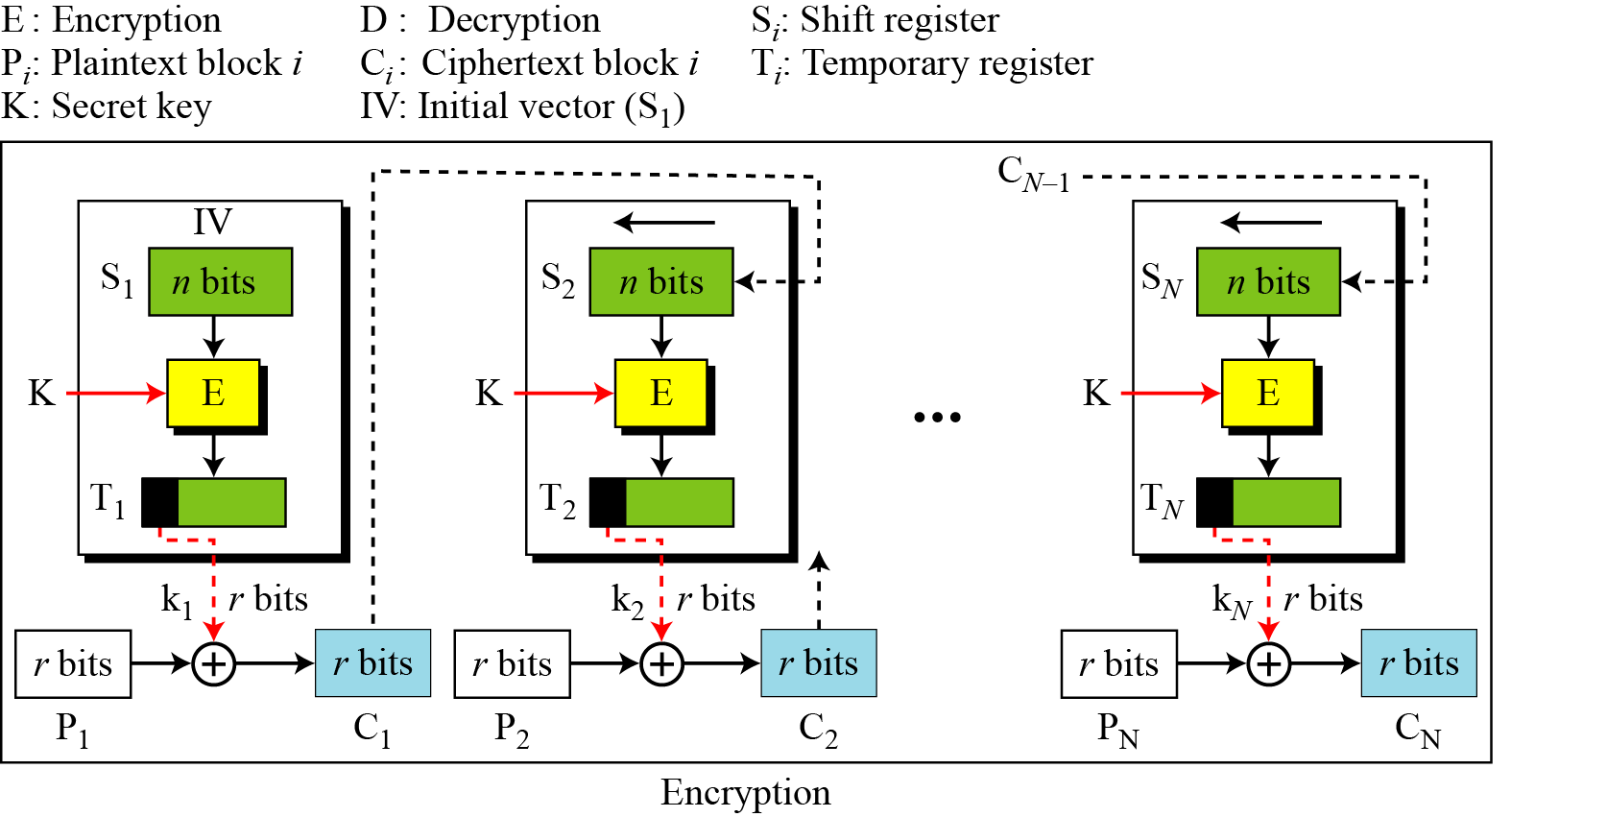
8.1.3 Cipher Feedback (CFB) Mode
In some situations, we need to use DES or AES as secure ciphers, but the plaintext or ciphertext block sizes are to be smaller.
Figure 8.4 Encryption in cipher feedback (CFB) mode

Slide 16

8.1.3 Continued
Note
In CFB mode, encipherment and decipherment use the encryption function of the underlying block cipher.
The relation between plaintext and ciphertext blocks is shown below:

Slide 17
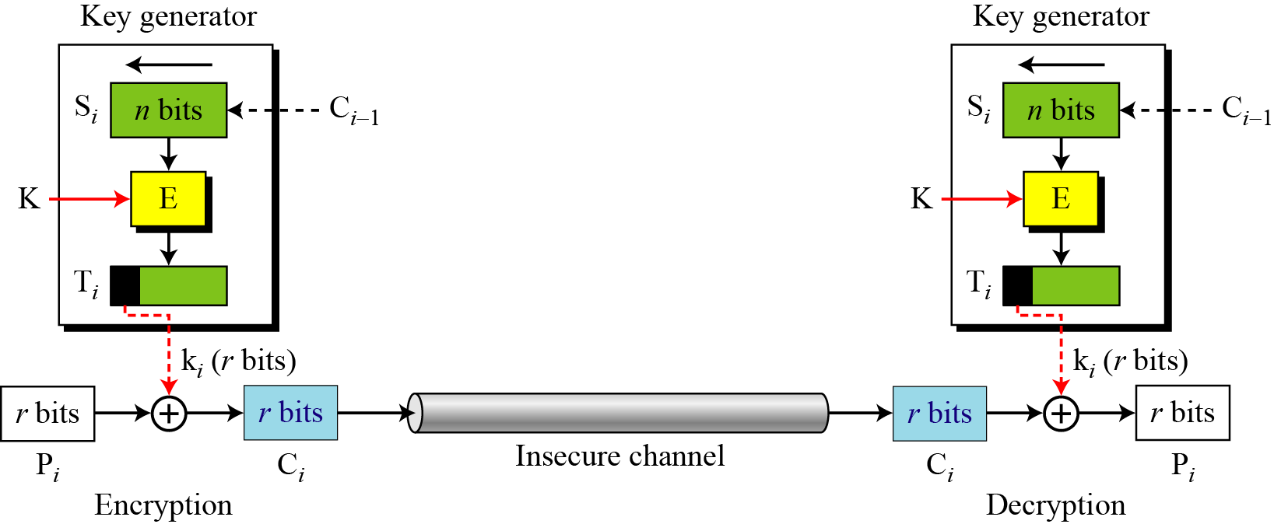
8.1.3 Continued
CFB as a Stream Cipher
Figure 8.5 Cipher feedback (CFB) mode as a stream cipher

Slide 18
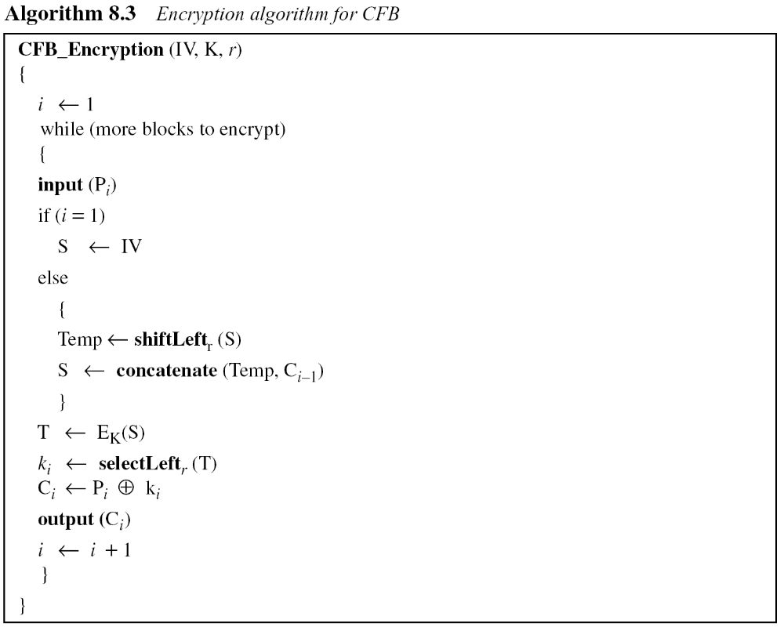
8.1.3 Continued

Slide 19
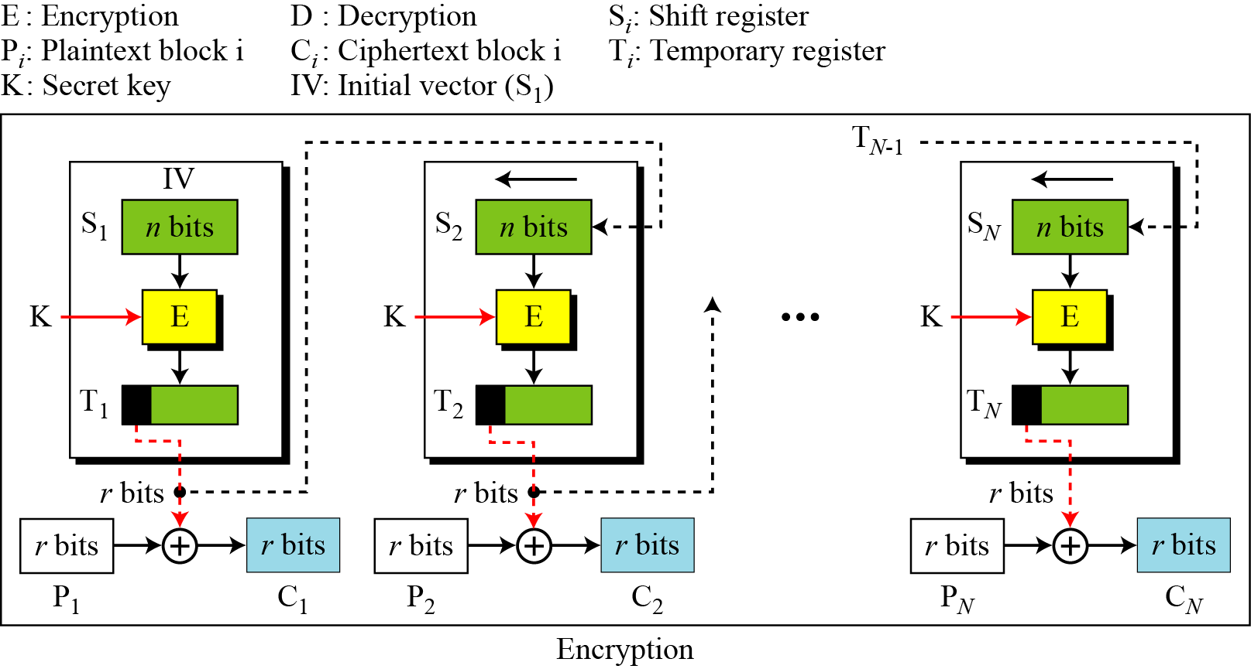
18.1.4 Output Feedback (OFB) Mode
In this mode each bit in the ciphertext is independent of the previous bit or bits. This avoids error propagation.
Figure 8.6 Encryption in output feedback (OFB) mode

Slide 20
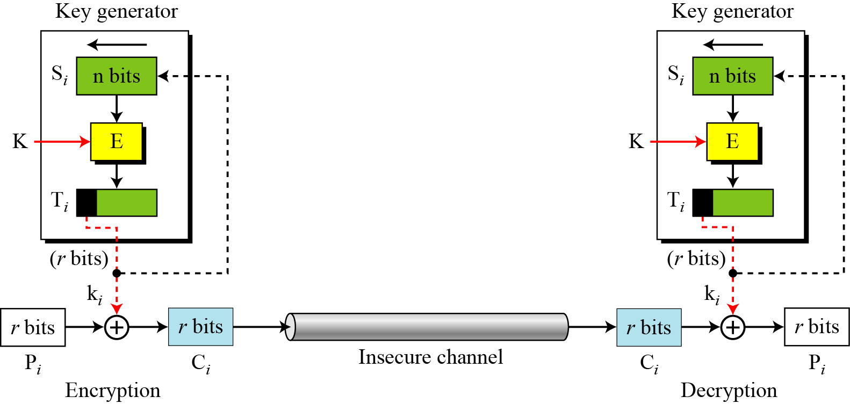
8.1.4 Continued
OFB as a Stream Cipher
Figure 8.7 Output feedback (OFB) mode as a stream cipher

Slide 21
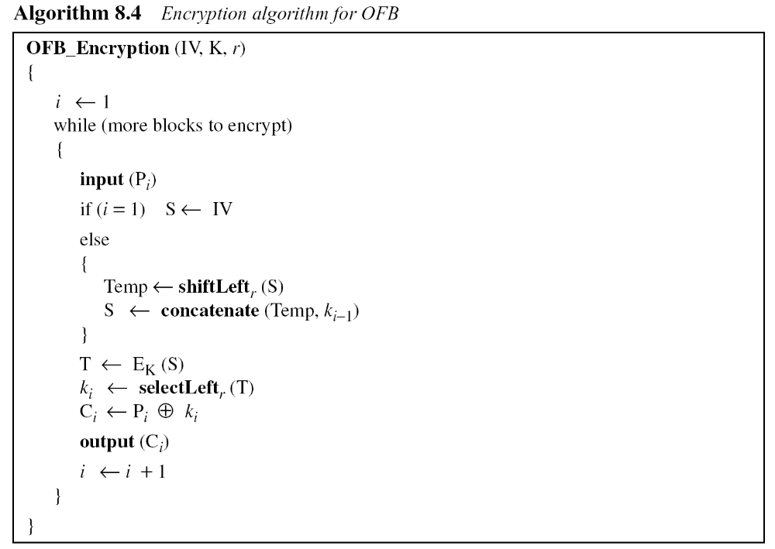
8.1.4 Continued

Slide 22
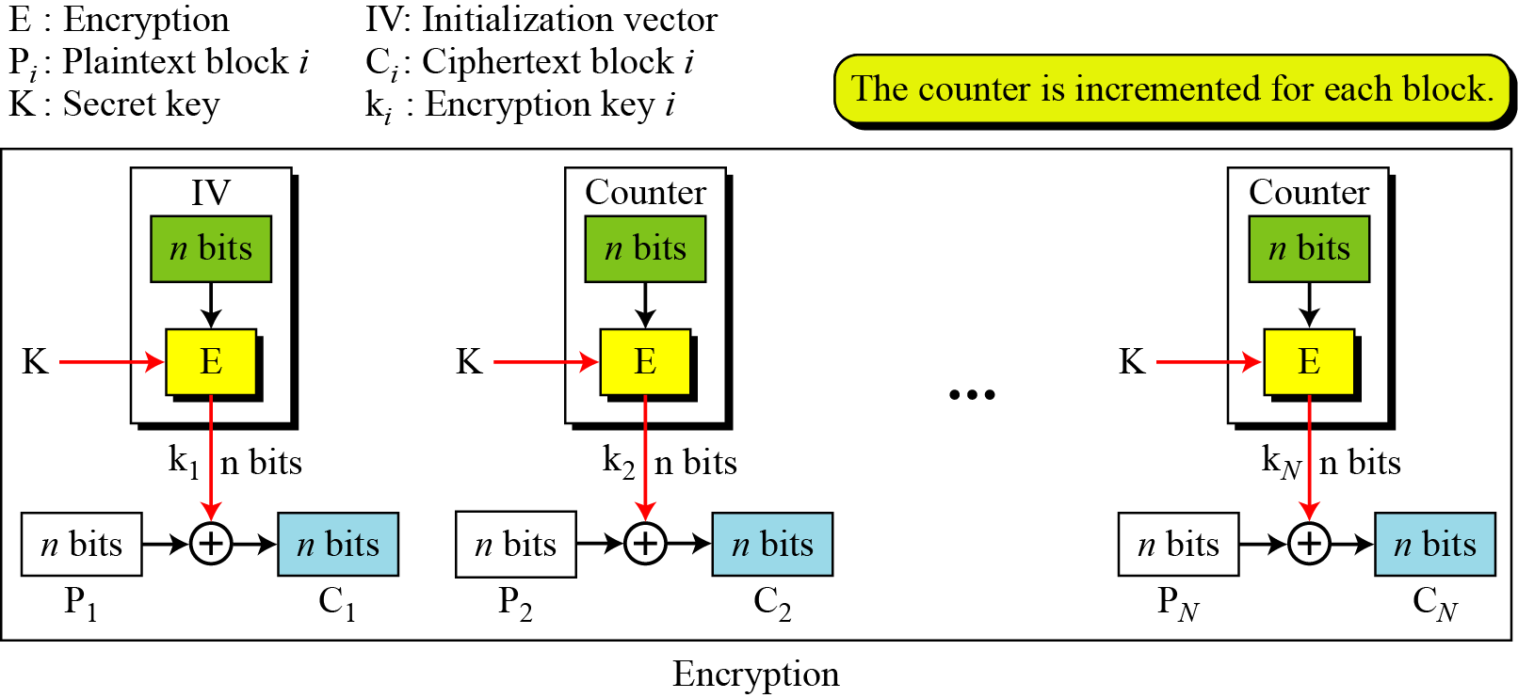
8.1.5 Counter (CTR) Mode
In the counter (CTR) mode, there is no feedback. The pseudorandomness in the key stream is achieved using a counter.
Figure 8.8 Encryption in counter (CTR) mode

Slide 23
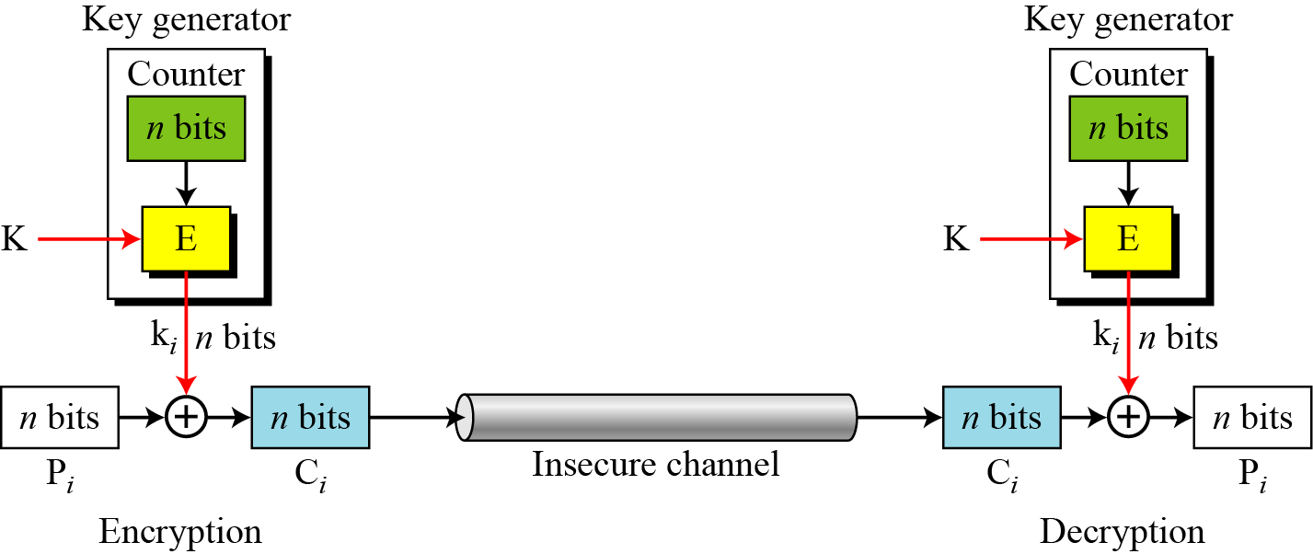
8.1.5 Continued
Figure 8.9 Counter (CTR) mode as a stream cipher

Slide 24
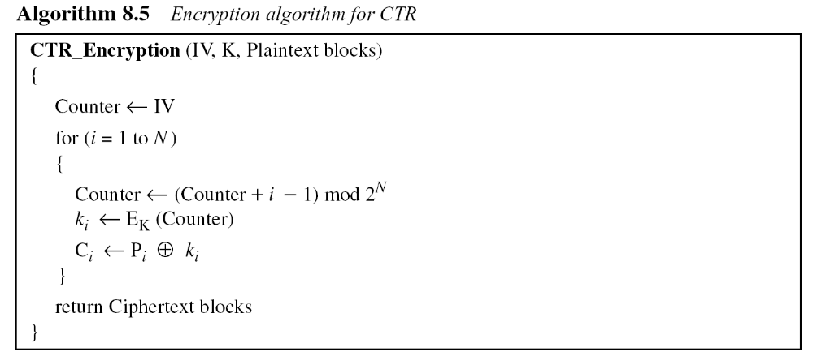
8.1.5 Continued

Slide 25
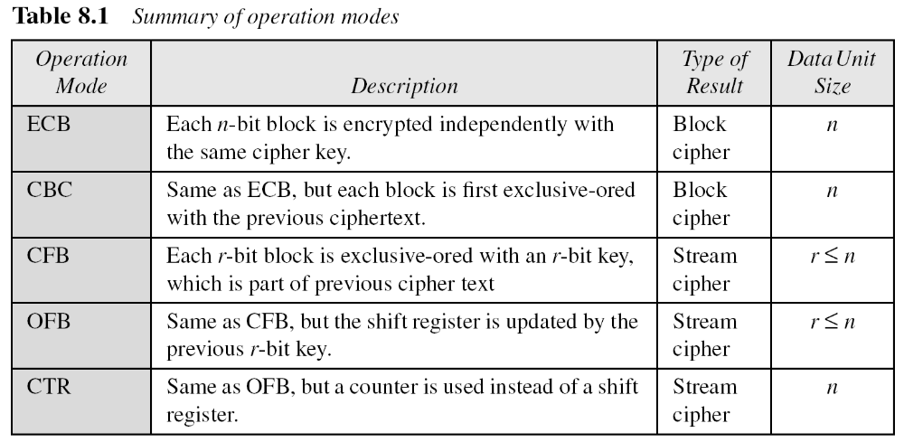
8.1.5 Continued
Comparison of Different Modes

Slide 26
8-2 USE OF STREAM CIPHERS
Although the five modes of operations enable the use of block ciphers for encipherment of messages or files in large units and small units, sometimes pure stream are needed for enciphering small units of data such as characters or bits.
Topics discussed in this section:
8.2.1 RC4
8.2.2 A5/1

Slide 27
8.2.1 RC4
RC4 is a byte-oriented stream cipher in which a byte (8 bits) of a plaintext is exclusive-ored with a byte of key to produce a byte of a ciphertext.
State
RC4 is based on the concept of a state.

Slide 28
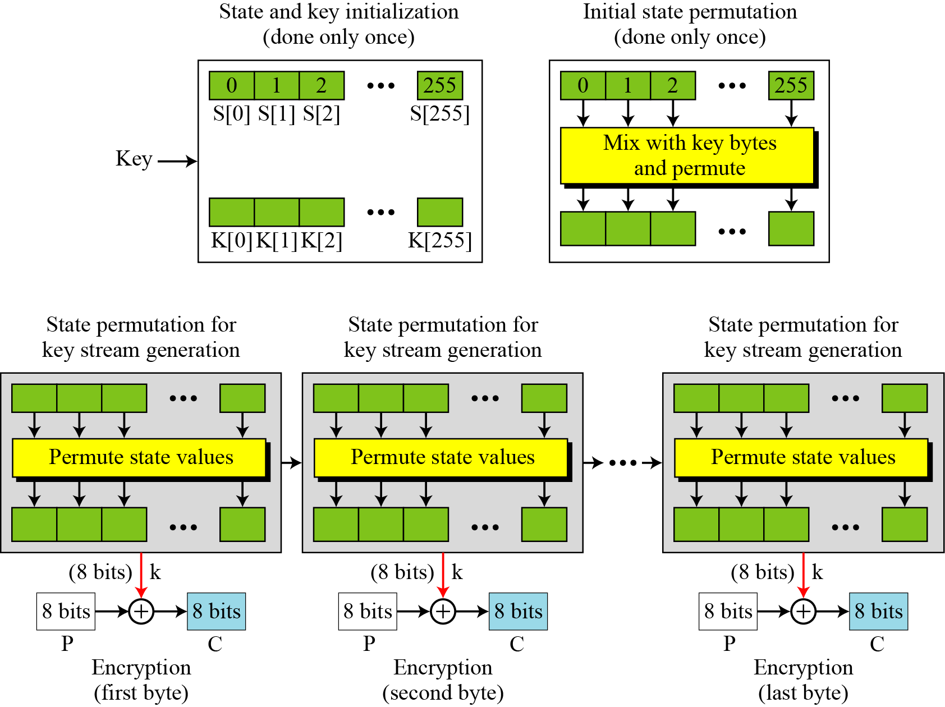
8.2.1 Continued
Figure 8.10 The idea of RC4 stream cipher

Slide 29
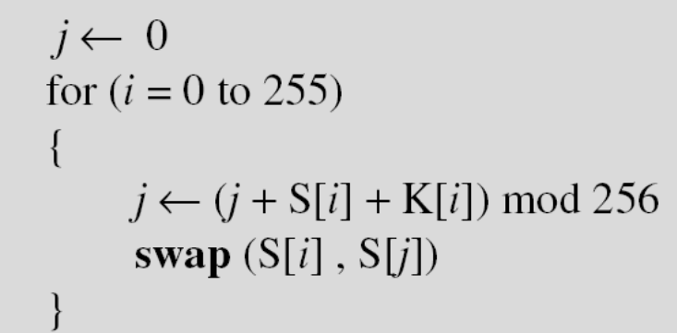
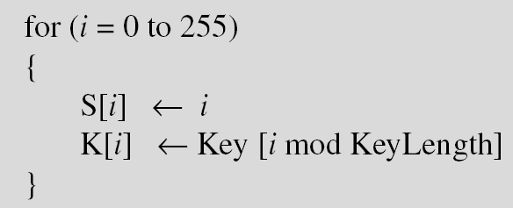
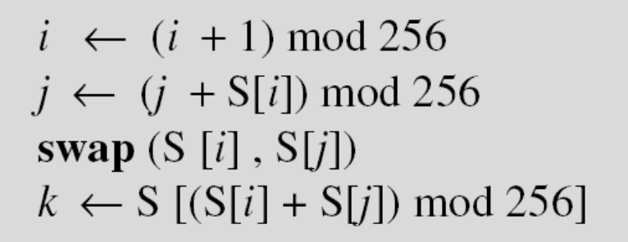
8.2.1 Continued
Initialization
Initialization is done in two steps:
Key Stream Generation
The keys in the key stream are generated, one by one.

Slide 30
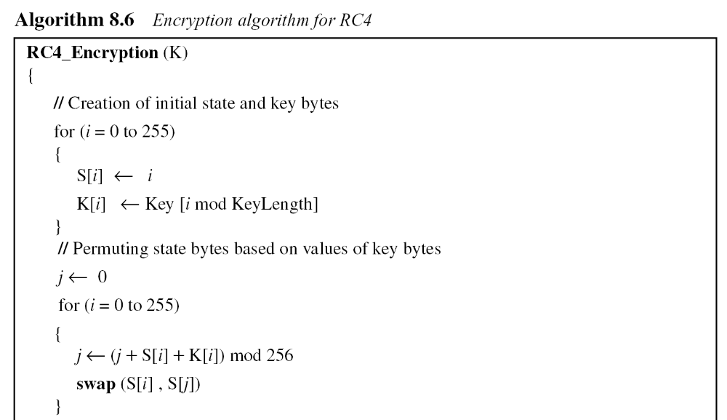
8.2.1 Continued
Algorithm

Slide 31
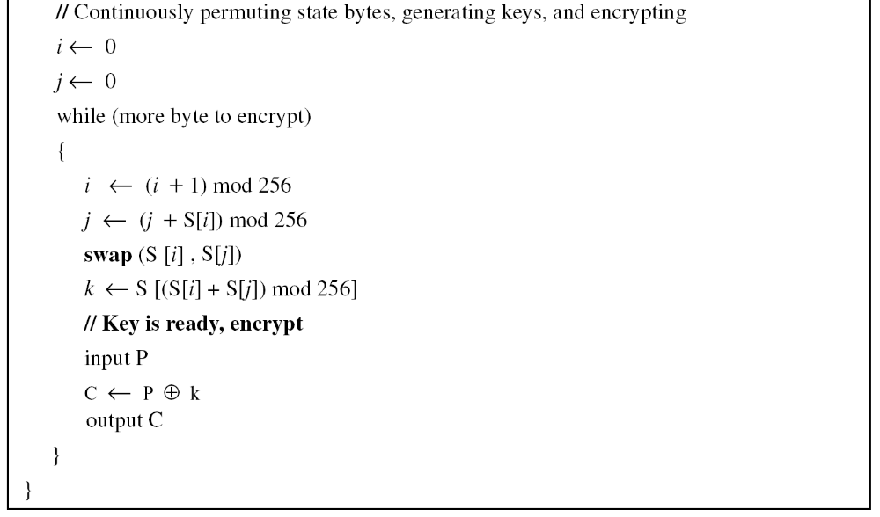
8.2.1 Continued
Algorithm Continued

Slide 32
8.2.1 Continued
Example 8.5
To show the randomness of the stream key, we use a secret key with all bytes set to 0. The key stream for 20 values of k is (222, 24, 137, 65, 163, 55, 93, 58, 138, 6, 30, 103, 87, 110, 146, 109, 199, 26, 127, 163).
Example 8.6
Repeat Example 8.5, but let the secret key be five bytes of (15, 202, 33, 6, 8). The key stream is (248, 184, 102, 54, 212, 237, 186, 133, 51, 238, 108, 106, 103, 214, 39, 242, 30, 34, 144, 49). Again the randomness in the key stream is obvious.

Slide 33
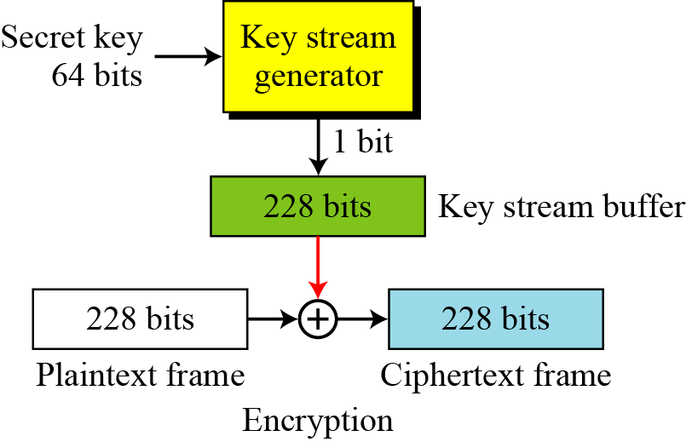
8.2.2 A5/1
A5/1 (a member of the A5 family of ciphers) is used in the Global System for Mobile Communication (GSM), a network for mobile telephone communication..
Figure 8.11 General outline of A5/1

Slide 34
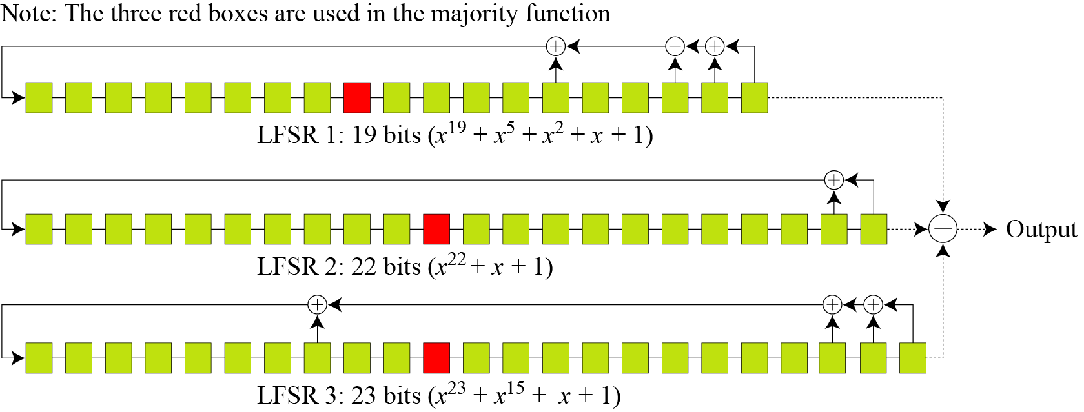
8.2.2 Continued
Key Generator
A5/1 uses three LFSRs with 19, 22, and 23 bits.
Figure 8.12 Three LFSR’s in A5/1

Slide 35
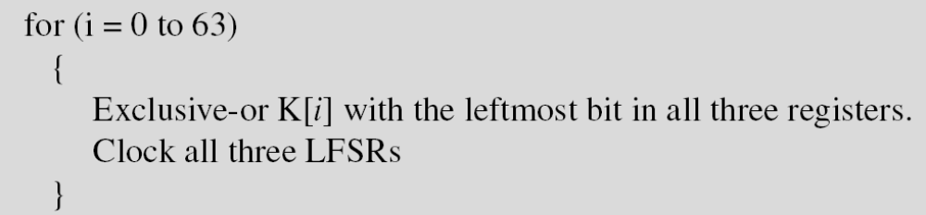
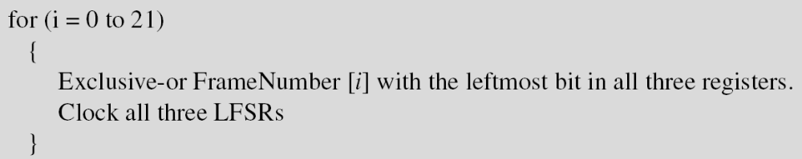
8.2.2 Continued
Initialization
1. set all bits in three LFSRs to 0.
2.
3.

Slide 36
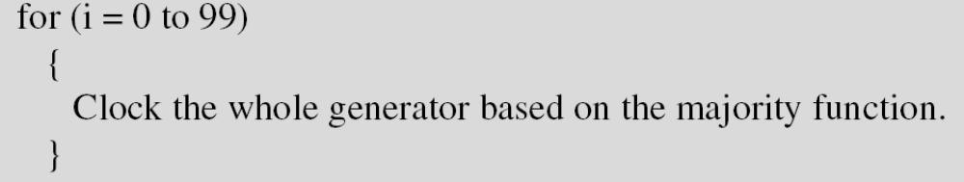
8.2.2 Continued
4.

Slide 37
8.2.2 Continued
Example 8.7
At a point of time the clocking bits are 1, 0, and 1. Which LFSR is clocked (shifted)?
Solution
The result of Majority (1, 0, 1) = 1. LFSR1 and LAFS3 are shifted,
but LFSR2 is not.

Slide 38
8.2.2 Continued
Encryption/Decryption
The bit streams created from the key generator are buffered to form a 228-bit key that is exclusive-ored with the plaintext frame to create the ciphertext frame. Encryption/decryption is done one frame at a time.

Slide 39
8-3 OTHER ISSUES
Encipherment using symmetric-key block or stream ciphers requires discussion of other issues.
Topics discussed in this section:
8.3.1 Key Management
8.3.2 Key Generation

Slide 40
8.3.1 Key Management
Alice and Bob need to share a secret key between themselves to securely communicate using a symmetric-key cipher. If there are n entities in the community,
n(n − 1)/2 keys are needed.
Note
Key management is discussed in Chapter 15.

Slide 41
8.3.2 Key Generation
Different symmetric-key ciphers need keys of different sizes. The selection of the key must be based on a systematic approach to avoid a security leak. The keys need to be chosen randomly. This implies that there is a need for random (or pseudorandom) number generator.
Note
Random number generators are discussed in Appendix K.

